Slide 1
Thoracic Surgery – A Retrospective Post-Operative Life Expectancy Study
James Davydov
Machine Learning – Fall 2019

Slide 2
Background and Data
Lung cancer is one of the leading cancer killers among the world’s population
When treatable, patients require surgery to remove cancerous tissues
Study aims to evaluate factors and co-morbidities related to the post-operative life expectancy of lung cancer patients, 1 year post surgery
Retrospective study done in 2013, of patients operated on between 2007 and 2011
Dataset of 470 patients, 400 alive and 70 dead
17 attributes

Slide 3
Attribute | Description
Diagnosis | ICD-10 codes for primary and secondary as well multiple tumors if any
FVC | Amount of air which can be forcibly exhaled from the lungs after taking the deepest breath possible
FEV | Volume that has been exhaled at the end of the first second of forced expiration
Performance | Performance status on Zubrod scale, Good (0) to Poor (2)
Pain | Pain before surgery (T = 1, F = 0)
Hemoptysis | Coughing up blood, before surgery (T = 1, F = 0)
Dyspnea | Difficulty or labored breathing, before surgery (T = 1, F = 0)
Cough | Symptoms of Coughing, before surgery (T = 1, F = 0)
Weakness | Weakness, before surgery (T = 1, F = 0)
Tumor_Size | T in clinical TNM - size of the original tumor, 1 (smallest) to 4 (largest)
Diabetes_Mellitus | Type 2 diabetes mellitus (T = 1, F = 0)
MI_6mo | Myocardial infarction (Heart Attack), up to 6 months prior(T = 1, F = 0)
PAD | Peripheral arterial diseases (T = 1, F = 0)
Smoking | Patient smoked (T = 1, F = 0)
Asthma | Patient has asthma (T = 1, F = 0)
Age | Age at surgery
Death_1yr | 1 year survival period - (T) value if died (T = 1, F = 0)

Slide 4
Code
Cleanup of dataset
Rename columns
Coerce dataset into data matrix for easier comprehension when modeling
Splitting data into training and test sets
Performing feature selection using randomForest and RFE
Determined the top 5 predictive variables: FVC, FEV, Diagnosis, Tumor Size, and Age
Building a predictive model using recursive partitioning which works for a binomial classification problem. Also integrating cross-validation to improve model.
Building an AUC plot
Notes:
2. Note on validation set
3. The variables make sense, most impactful on lung cancer patients

Slide 5
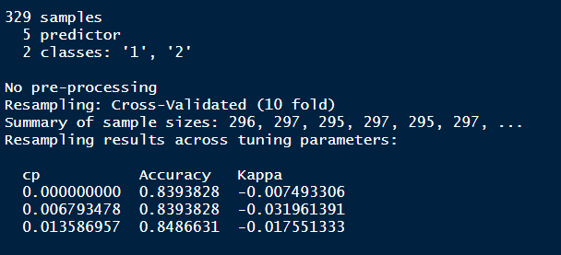
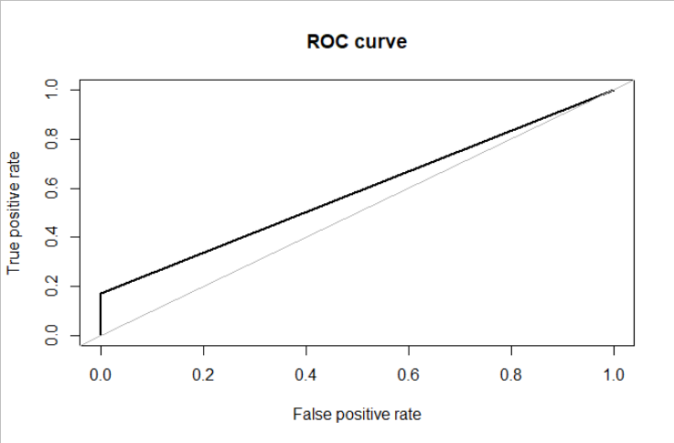
Results
Cross-validated model had a ~85% accuracy in predicting life expectancy
Poor ROC curve, showing a 58.6% AUC

Slide 6
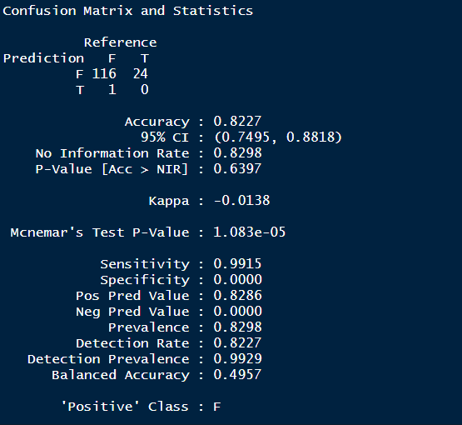
Confusion Matrix on Test Data

Slide 7
THANK YOU!

